Slide 1


Studio Shodwe
Home
About Us
Genre
Service
Booking
CINEMASTER SYSTEM
Dr . we'am adel mahmoud talafha
Noor Diab Omar Al Sharabati
Malak Husam Mohammed Naji Alshalabi
Raneem Waddah Mahmoud Tumar
Explore Now

Slide 2
Studio Shodwe
Home
About Us
Genre
Service
Booking
PHASE I:
PREPARE SCENARIO THAT DESCRIBES THE PROPOSED SYSTEM, ITS OBJECTIVES AND FUNCTIONALITY AS WELL AS THE DATA NEEDED FOR IT AND CREATE AN ERD FOR THAT.
Explore Now

Slide 3

Consider the following information about a cinema database:
• A movie is identified by a unique movie ID. Each movie has a title, duration, release date, category, and rating.
• A movie can be shown in one or more showtimes. Each showtime has a unique number, a show date, and
a show time.
• Each showtime is scheduled in exactly one hall. A hall is identified by a hall number and has a hall name and a seating capacity.
• If a hall is removed from the system, the showtimes inside it are removed as well since they depend on the hall.
• Customers can purchase tickets for a showtime. A ticket has a ticket number, a seat number, price, and date of purchase.
• A customer may buy many tickets for different showtimes, and a single showtime may have many tickets sold to different customers.
• A customer is identified by a customer ID and has a name, phone number, and registration date.
• For reporting, a cinema must be able to show which movies are available on a certain date and the total number of tickets sold for each movie.

Slide 4
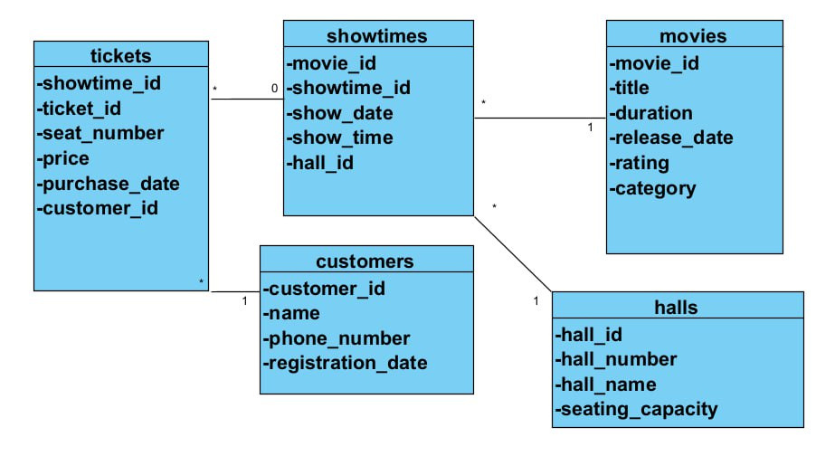

Slide 5
Studio Shodwe
Home
About Us
Genre
Service
Booking
PHASE II:
MAP THE ERD INTO RELATIONAL DATABASE:
DESIGN THE TABLES.
IDENTIFY TABLES COLUMNS (ATTRIBUTES) WITH THEIR DATA TYPE, SIZE, NULL CONSTRAINT, DOMAIN CONSTRAINT AND PRIMARY KEY.
IDENTIFY REFERENTIAL INTEGRITY CONSTRAINTS (I.E. IDENTIFY FOREIGN KEYS BETWEEN TABLES).
Explore Now

Slide 6
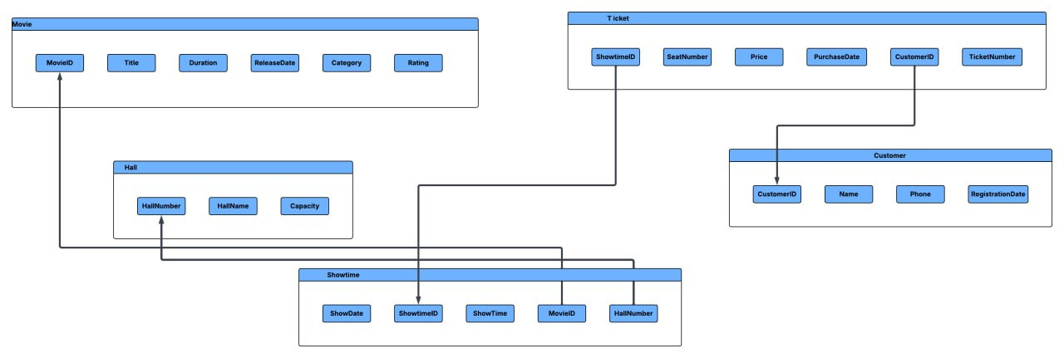

Slide 7
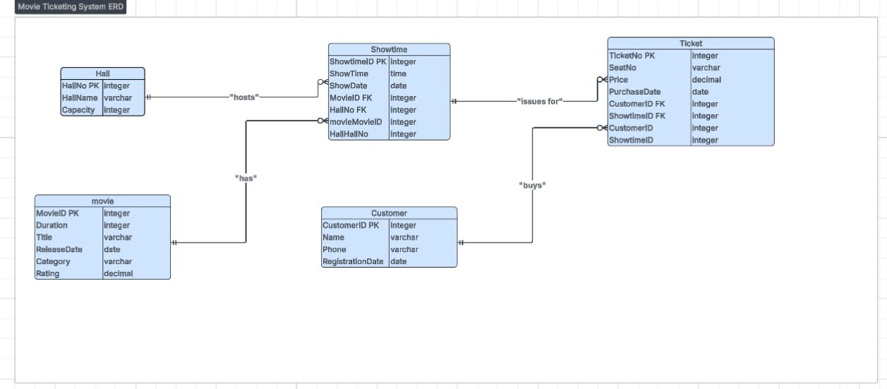

Slide 8
Studio Shodwe
Home
About Us
Genre
Service
Booking
PHASE III:
WRITE SQL QUERIES THAT:
CREATE THE DATABASE.
CREATE THE TABLES.
CREATE PRIMARY KEYS, FOREIGN KEYS AND ANY OTHER CONSTRAINTS.
INSERT SAMPLE DATA TO DIFFERENT TABLES.
RETRIEVE (SELECT) SOME DATA FROM SINGLE TABLE AND FROM MULTI TABLES.
RETRIEVE SOME AGGREGATE DATA SUCH AS SUM, AVERAGE, MINIMUM AND MAXIMUM.
Explore Now

Slide 9
CREATE DATABASE CinemaDB;
USE CinemaDB;
CREATE TABLE Movies (
MovieID INT IDENTITY(1,1),
Title VARCHAR(100) NOT NULL,
Duration INT NOT NULL,
ReleaseDate DATE NOT NULL,
Category VARCHAR(50),
Rating DECIMAL(3,1) CHECK (Rating BETWEEN 0 AND 10),
CONSTRAINT PK_Movies PRIMARY KEY (MovieID)
);
CREATE TABLE Halls (
HallNumber INT,
HallName VARCHAR(50) NOT NULL,
SeatingCapacity INT CHECK (SeatingCapacity > 0),
CONSTRAINT PK_Halls PRIMARY KEY (HallNumber)
);

Slide 10
CREATE TABLE ShowTimes (
ShowTimeID INT IDENTITY(1,1),
MovieID INT NOT NULL,
HallNumber INT NOT NULL,
ShowDate DATE NOT NULL,
ShowTime TIME NOT NULL,
CONSTRAINT PK_ShowTimes PRIMARY KEY (ShowTimeID),
CONSTRAINT FK_ShowTimes_Movies FOREIGN KEY (MovieID)
REFERENCES Movies(MovieID),
CONSTRAINT FK_ShowTimes_Halls FOREIGN KEY (HallNumber)
REFERENCES Halls(HallNumber)
ON DELETE CASCADE
);
CREATE TABLE Customers (
CustomerID INT IDENTITY(1,1),
CustomerName VARCHAR(100) NOT NULL,
PhoneNumber VARCHAR(20),
RegistrationDate DATE NOT NULL,
CONSTRAINT PK_Customers PRIMARY KEY (CustomerID)
);

Slide 11
CREATE TABLE Tickets (
TicketNumber INT IDENTITY(1,1),
ShowTimeID INT NOT NULL,
CustomerID INT NOT NULL,
SeatNumber VARCHAR(10) NOT NULL,
Price DECIMAL(6,2) CHECK (Price > 0),
PurchaseDate DATE NOT NULL,
CONSTRAINT PK_Tickets PRIMARY KEY (TicketNumber),
CONSTRAINT FK_Tickets_ShowTimes FOREIGN KEY (ShowTimeID)
REFERENCES ShowTimes(ShowTimeID),
CONSTRAINT FK_Tickets_Customers FOREIGN KEY (CustomerID)
REFERENCES Customers(CustomerID)
);

Slide 12
INSERT INTO Movies (Title, Duration, ReleaseDate, Category, Rating)
VALUES
('Inception', 148, '2010-07-16', 'Sci-Fi', 8.8),
('Avatar', 162, '2009-12-18', 'Action', 7.9),
('Interstellar', 169, '2014-11-07', 'Sci-Fi', 8.6);
INSERT INTO Halls (HallNumber, HallName, SeatingCapacity)
VALUES
(1, 'Main Hall', 200),
(2, 'VIP Hall', 100);
INSERT INTO ShowTimes (MovieID, HallNumber, ShowDate, ShowTime)
VALUES
(1, 1, '2025-01-10', '18:00'),
(1, 2, '2025-01-10', '21:00'),
(2, 1, '2025-01-11', '19:00'),
(3, 2, '2025-01-11', '20:30');

Slide 13
INSERT INTO Customers (CustomerName, PhoneNumber, RegistrationDate)
VALUES
('Ahmad Ali', '0791111111', '2024-12-01'),
('Sara Khaled', '0782222222', '2024-12-05'),
('Omar Hassan', '0773333333', '2024-12-10');
INSERT INTO Tickets (ShowTimeID, CustomerID, SeatNumber, Price, PurchaseDate)
VALUES
(1, 1, 'A1', 8.00, '2025-01-05'),
(1, 2, 'A2', 8.00, '2025-01-05'),
(2, 1, 'B1', 10.00, '2025-01-06'),
(3, 3, 'C5', 7.50, '2025-01-07'),
(4, 2, 'D3', 9.00, '2025-01-08');

Slide 14
SELECT * FROM Movies;
SELECT * FROM Customers;
SELECT Movies.Title,ShowTimes.ShowDate,ShowTimes.ShowTime,Halls.HallName
FROM ShowTimes
JOIN Movies ON ShowTimes.MovieID = Movies.MovieID
JOIN Halls ON ShowTimes.HallNumber = Halls.HallNumber;
SELECT Movies.Title, COUNT(Tickets.TicketNumber) AS TotalTicketsSold
FROM Movies
JOIN ShowTimes ON Movies.MovieID = ShowTimes.MovieID
LEFT JOIN Tickets ON ShowTimes.ShowTimeID = Tickets.ShowTimeID
GROUP BY Movies.Title;

Slide 15
SELECT AVG(Price) AS AverageTicketPrice
FROM Tickets;
SELECT MIN(Price) AS MinPrice, MAX(Price) AS MaxPrice
FROM Tickets;
SELECT SUM(Price) AS TotalRevenue
FROM Tickets;
SELECT Movies.Title, ShowTimes.ShowDate,COUNT(Tickets.TicketNumber) AS TicketsSold
FROM Movies
JOIN ShowTimes ON Movies.MovieID = ShowTimes.MovieID
LEFT JOIN Tickets ON ShowTimes.ShowTimeID = Tickets.ShowTimeID
WHERE ShowTimes.ShowDate = '2025-01-10'
GROUP BY Movies.Title, ShowTimes.ShowDate;

Slide 16
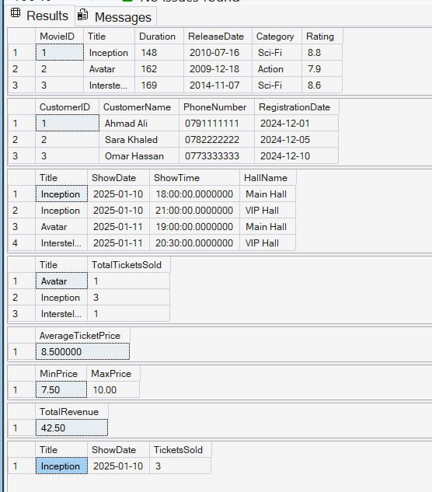

Slide 17
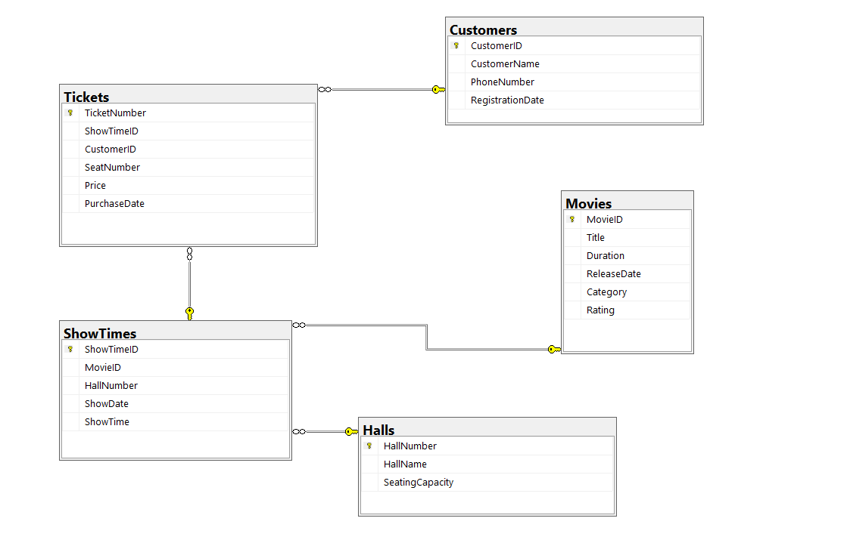

Slide 18

Studio Shodwe
Home
About Us
Genre
Service
Booking
THANK YOU

